Slide 1


2017 Contract Negotiations
OVERVIEW OF CUPE LOCAL 3903 TOP PRIORITIES FOR
THE 2017 COLLECTIVE AGREEMENT
1

Slide 2

Undergrad-centric unionism
We are an undergrad-centric union of educators, student-educators and researchers who care equally about the student, public education and
the community.
2

Slide 3
Changing Provincial Funding Model for Universities
Contract and part-time faculty should finally matter to the University’s bottom line because performance-based funding rests on the academic outcomes of the undergraduates we teach.
3

Slide 4
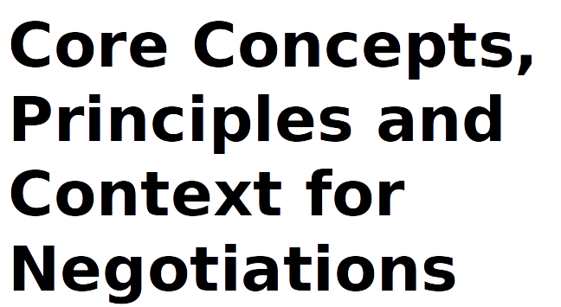
4

Slide 5
Academic scholarship supports
CUPE 3903 solutions
Jaeger and Eagan Jr (2009) show that graduation rates decline as non-tenure track faculty increase.
MK Eagan and AJ Jaeger. 2009. “Effects of exposure to part-time faculty on community college transfer” Research in Higher Education, 50(2), 168.
5

Slide 6
Job security = Better Educational Outcomes For Undergraduates
“Recent studies have found a negative relationship between the use of part-time faculty members on persistence (Eagan, Jaeger, & Thornton, 2008) and graduation rates (Ehrenberg & Zhang, 2005; Jacoby, 2006)”
Paul D. Umbach. 2008. The Effects of Part-time Faculty Appointments
On Instructional Techniques and Commitment to Teaching. Paper
Presented at the 33rd Annual Conference of the Association for the
Study of Higher Education, Jackonsonville, Florida, Nov 5-8.
6

Slide 7
Job security = Better Undergraduate Experience
“At a time of major change throughout higher education, numerous critics believe strongly that the growing use of contingent faculty has negative consequences, especially for undergraduate education (AAUP, 2010; Benjamin, 1998, 2002, 2003; Hagedorn, Perrakis, & Maxwell, 2002; Schibik & Harrington, 2002)”.
Roger G Baldwin and Matthew R Wawrzynski. 2011. “Contingent Faculty as Teachers: What We Know; What We Need to Know” American Behavioral Scientist, 55(11), p. 1487.
7

Slide 8
Job security = Educational Effectiveness
“Comparing tenure-track to non-tenure track found that tenure-track jobs are associated with better student learning, undergraduate research, active and collaborative learning, problem-based learning and student-centered or multicultural approaches to teaching”
Adrianna Kezar and Daniel Maxey. 2013. The Changing Academic
Workforce. May/June,
taken from: https://www.agb.org/trusteeship/2013/5/changing- academic-workforce
8

Slide 9
Job Security =
Better Undergraduate Performance
“There is considerable concern that large numbers of contingent faculty make it difficult for students to interact with and build long-term relationships with their instructors.”
Roger G Baldwin and Matthew R Wawrzynski. 2011. “Contingent Faculty as Teachers: What We Know; What We Need to Know” American Behavioral Scientist, 55(11), p. 1487.
9

Slide 10
Job Security helps students go farther in their disciplines
“Some scholars have reported that [non-tenured track] faculty can negatively affect graduation rates (Ehrenberg & Zhang, 2004; Jaeger & Eagan, 2009) and transfer rates (Eagan & Jaeger, 2009), that they can negatively affect retention (Jaeger & Eagan, 2011), and that they do not properly prepare students for courses later in a discipline’s sequence (Burgess & Samuels, 1999).”
Jennifer Danley-Scott and Gray Scott. 2014. “The Other Half: Non-Tenure Track Faculty Thoughts on Student Learning Outcomes Assessment” Research & Practice in Assessment, Vol. 9, Summer, p. 32
10

Slide 11
Job Security = Better Educational Outcomes for Undergraduates
“After controlling for student background characteristics, prior achievement, financial aid measures, and enrollment traits, the significant negative relationship between retention and high levels of exposure to part-time faculty persisted” (Jaeger and Eagen, 2011: 508).
Audrey J. Jaegar and M. Kevin Eagan. 2010. “Examining Retention and Contingent Faculty Use in a State System of Public Higher Education” Education Policy XX(X), p. 1.
11

Slide 12
Teaching Assistants improve equity and participation in STEM
Research reveals [graduate teaching assistants] play an important role in the quality of undergraduate education and influence the retention of students to major in the sciences, particularly minority and females students (Gardner & Jones, 2011; Wheeler et al, 2017 464).
Lindsay Wheeler et al. 2017. “Do Teaching Assistant Matter?” Journal of Research in Science Teaching, 54(4), pp. 463-492
Grant Gardner and Gail Jones. 2011. “Pedagogical Preparation of the Science Graduate Teaching Assistants:Challenges and Implications” Science Educator, 20(2), pp. 31-41.
12

Slide 13
Professional Development for part-time employees is critical to undergraduate success
“Given that TAs are responsible for a sizeable amount of teaching activities related to undergraduate instruction, it is important to ensure that they receive training that is sufficient to support them as effective instructors” (Boman, 2008: 4).
J.S. Boman. 2008. Outcomes of a Graduate Teaching Assistant
Training Program. PhD Thesis. University of Western Ontario. London: Ontario.
13

Slide 14
Key Priorities & Issues for Negotiations
(and survey results)
14

Slide 15
Summer Funding for Unit 1
We are proposing bringing the fellowship model into the collective agreement.
15

Slide 16
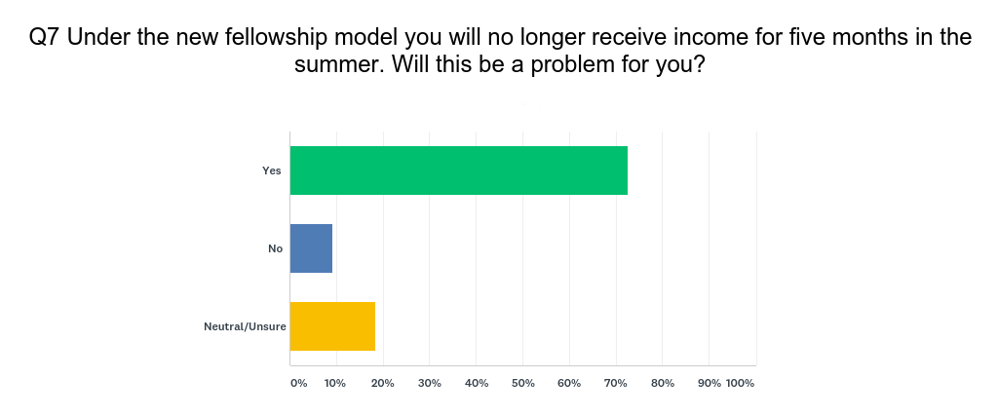
Over 70% of respondents faced summer hardship due to the fellowship model
16

Slide 17
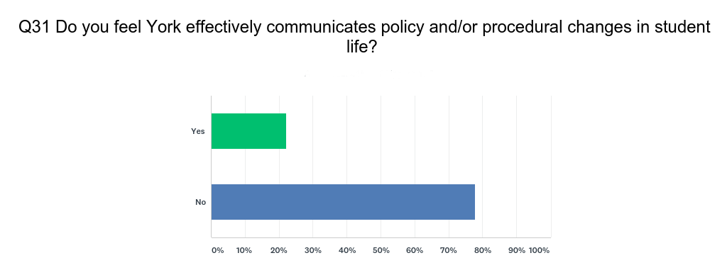
A supermajority of respondents feel communication is broken
17

Slide 18
The Restoration of Unit Three Jobs
There are hundreds of graduate students at York who come to their studies as students with lived experience of disability. Some use their knowledge to produce research that contributes to social change.
Securing these students with an accommodation policy and health benefits would allow for access to post-graduate education they may otherwise not have.
18

Slide 19
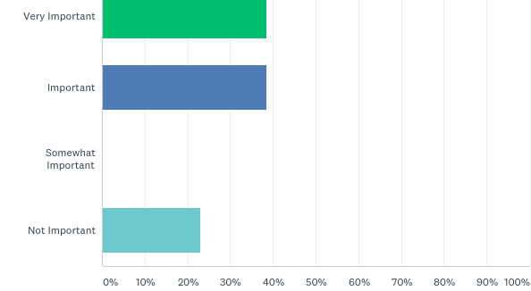
In choosing to attend York University, how important was the strength of CUPE 3903's healthcare plan in that decision
19

Slide 20
Health Care Plan
The health benefits package at York is a key tool for recruiting and retaining 3903 members, but there are some areas of the plan that have not kept pace with the changing needs of members.
20

Slide 21
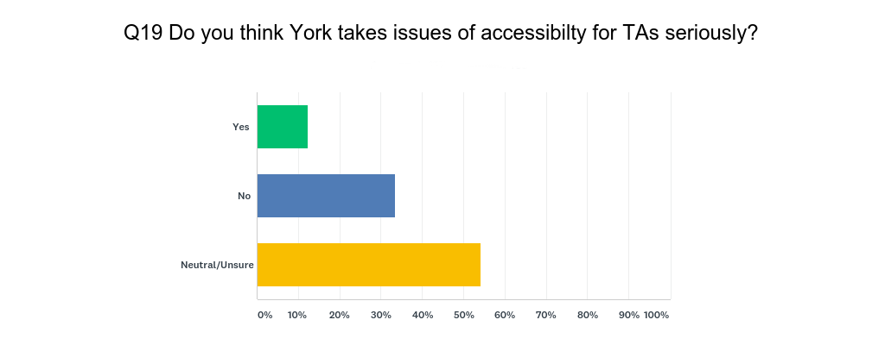
A majority of respondents feel accessibility
Is not treated seriously on campus
21

Slide 22
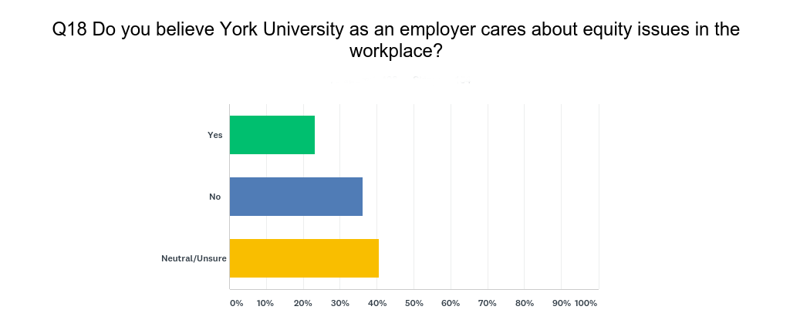
A majority of respondents feel the
employer does not take equity issues seriously
22

Slide 23
Improvements in Professional Development
As Ontario changes its funding model for higher education, funding will be increasingly linked to performance. This makes the professional development of educators crucial to the bottom line.
23

Slide 24
Job Security
York’s dependence on short-term contracts is out of touch with Ontario’s changing employment standards. Ninety three per cent of Unit 2 members strongly agreed job security is a priority.
24

Slide 25
Salary Rates
Housing affordability and the cost of living in Toronto has reached crisis levels. The wage increases of the past are out of keeping with current price changes, especially for those below the low-income cut off.
25

Slide 26
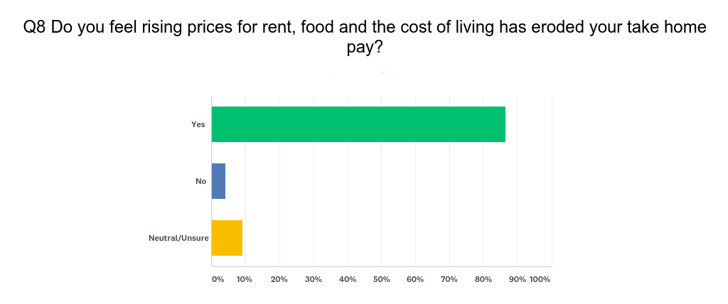
Nearly 90% of respondents feel that the current salary rates are no longer adequate
26

Slide 27
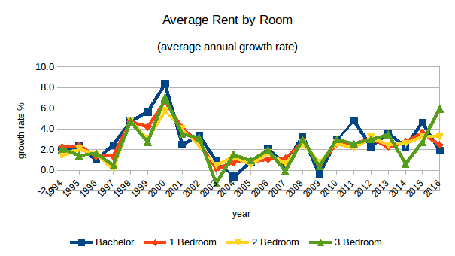
Rental prices on all types of housing has increased by more than 2% a year since 2009
www.cmhc-schl.gc.ca
27

Slide 28
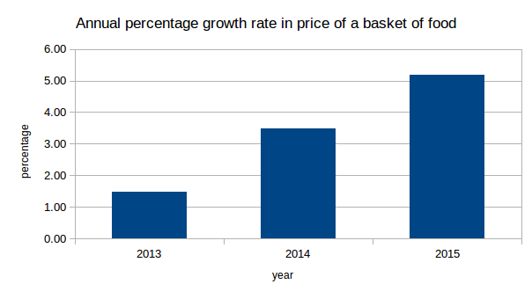
The prices of a basket of food increased by more than 5% in 2015
Source:CANSIM: 326-0012
*Monthly prices are convert to annual average
**Basket based on Market-baket Measure (Statscan MBM)
28

Slide 29
York’s financial operating performance
“The University posted a surplus of $23.3 million for the year ended April 30, 2016. Over the last three years, the University has recorded rising surpluses, which is in contrast to the periodic deficits of prior years.”
Dominion Bond Rating Service, Dec 2016, p.3
29

Slide 30
The Dominion Bond Rating Services shows York has the ability to pay
“The University’s balance sheet provides the institution with financial flexibility”.
“Significant financial and non-financial resources”
“The university owns 200 acres of developable land on its Keele Campus. The extension of the TTC subway line to campus is expected to increase the development potential and value of the land holdings.”
-Dominion Bond Rating Services, Dec 5 2016, p. 2
30

Slide 31
Let’s Work Together
31

