Slide 1
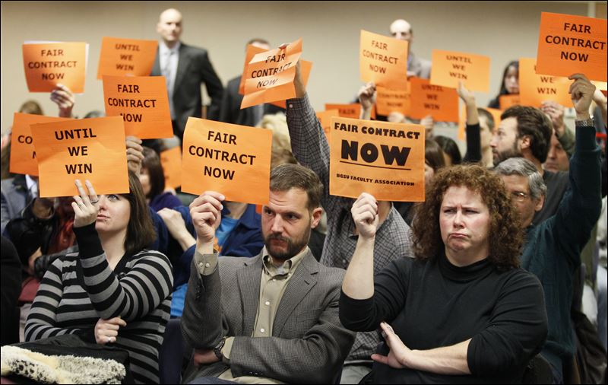
CUPE 3903 Unit 2 Job Security Proposals

Slide 2
YUFA/CUPE FACULTY COMPLEMENTS
 |  | YUFA |  | CONTRACT |  |  |  | YUFA |  | CONTRACT
2013 |  | 1,523 |  | 1774 |  | 1999 |  | 1149 |  | 918
2012 |  | 1480 |  | 1616 |  | 1998 |  | 1136 |  | 704
2011 |  | 1475 |  | 1707 |  | 1997 |  | 1132 |  | 674
2010 |  | 1466 |  | 1633 |  | 1996 |  | 1125 |  | 702
2009 |  | 1465 |  | 1582 |  | 1995 |  | 1170 |  | 796
2008 |  | 1528 |  | 1591 |  | 1994 |  | 1178 |  | 860
2007 |  | 1520 |  | 1551 |  | 1993 |  | 1221 |  | 1018
2006 |  | 1451 |  | 1589 |  | 1992 |  | 1240 |  | 1317
2005 |  | 1415 |  | 1455 |  | 1991 |  | 1249 |  | 1401
2004 |  | 1357 |  | 1389 |  | 1990 |  | 1237 |  | 1449
2003 |  | 1279 |  | 899 |  | 1989 |  | 1200 |  | 1417
2002 |  | 1226 |  | 791 |  | 1988 |  | 1195 |  | 1302
2001 |  | 1214 |  | 819 |  | 1987 |  | 1168 |  | 1252
2000 |  | 1205 |  | 590 |  | 1986 |  | 1131 |  | 1164

Slide 3
ARTICLE 23 AFFIRMATIVE ACTION
“In recognition of the substantial contribution to the University community made by long-term employees, and of the obstacles that have faced these employees in their attempts to find academic employment, the parties have agreed to establish an Affirmative Action Program as outlined below. The parties agree that this Program is an ongoing commitment.”

Slide 4
Conversions 1988-2014
1988 8 1997 2 2006 8
1989 6 1998 1 2007 6
1990 6 1999 3 2008 6
1991 6 2000 4 2009 2
1992 1 2001 2 2010 2
1993 1 2002 5 2011 2
1994 2 2003 6 2012 2
1995 3 2004 3 2013 3
1996 4 2005 4 2014 2

Slide 5
Job Security Proposals: History
7. RENEWABLE TEACHING CONTRACTS (late 1990s)
The employer and the union agree to explore the viability of renewable multi-year teaching contracts (RTC’s) within the jurisdiction of the CUPE 3903 collective agreement. The parties agree to the implementation of a pilot project involving one or more hiring units as agreed between the parties
LETTER OF UNDERSTANDING – LONG SERVICE GUARANTEE (p. 84)
Employees who have at least fifteen years of service in the bargaining unit (in each year
of which at least one type 1 position was held, with at least three type 1 positions or
their equivalent in each of the last five years, and who submit a blanket application(s)
and/or submit specific applications for at least three type 1 positions or their equivalent
per their “’normal’ historical application profile” can normally expect to be offered at
least three type 1 positions in a given contract year.In the event that any such employee
is not offered at least three type 1 positions or their equivalent in a given contract year,
she shall be paid a stipend equaling 70% of the rate of each position fewer that three
type 1 positions or their equivalent and will receive applicable prior experience for
three type 1 positions
.

Slide 6
ARTICLE 24 LONG SERVICE TEACHING APPOINTMENTS (LSTAS)
Employees who effective September 1 preceding the date of the award of an LSTA, have been in the Unit 2 “Affirmative Action Pool” for a minimum of 5 years and who have taught at an intensity of an average of 2.5 FCEs over the three previous years (may include approved leaves) are eligible to apply for a Long Service Teaching Appointment. LSTAs will be awarded for a three year period and will consist of contract assignments comprising 3 full course equivalents in each of the three years ofthe term
.

Slide 7
ARTICLE 23 AFFIRMATIVE ACTION
“Furthermore, effective September 1, 2014, in light of the significant broadening of Alternate Stream tenure-track appointments in the 2012-2015 YUFA collective agreement, the parties agree to uphold their commitment to the Affirmative Action Program in order to meaningfully expand opportunities for long-term employees.”

Slide 9
